Slide 1
Agile tools (project tools, reporting tools, communication tools, metrics, CI)
Schmuter Norbert
NI Hungary Kft.

Slide 2
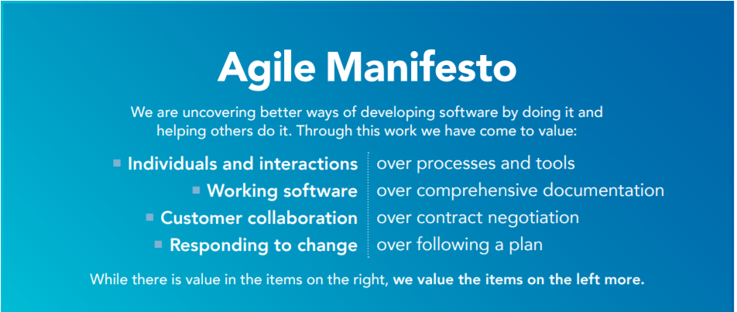

Slide 3
12 Principles behind Agile Manifesto
Our highest priority is to satisfy the customer through early and continuous delivery of valuable software.
Welcome changing requirements, even late in development. Agile processes harness change for the customer’s competitive advantage.
Deliver working software frequently, from a couple of weeks to a couple of months, with a preference to the shorter timescale.
Business people and developers must work together daily throughout the project.
Build projects around motivated individuals. Give them the environment and support they need and trust them to get the job done.

Slide 4
The most efficient and effective method of conveying information to and within a development team is face-to-face conversation.
Working software is the primary measure of progress.
Agile processes promote sustainable development. The sponsors, developers, and users should be able to maintain a constant pace indefinitely.
Continuous attention to technical excellence and good design enhances agility.
Simplicity–the art of maximizing the amount of work not done–is essential.
The best architectures, requirements, and designs emerge from self-organizing teams.
At regular intervals, the team reflects on how to become more effective, then tunes and adjusts its behavior accordingly.

Slide 5
Definition of done
The team agrees on, and displays prominently somewhere in the team room, a list of criteria which must be met before a product increment “often a user story” is considered “done”. Failure to meet these criteria at the end of a sprint normally implies that the work should not be counted toward that sprint’s velocity.
Expected Benefits:
  the Definition of Done provides a checklist which usefully guides pre-implementation activities: discussion, estimation, design
  the Definition of Done limits the cost of rework once a feature has been accepted as “done”
  having an explicit contract limits the risk of misunderstanding and conflict between the development team and the customer or product owner

Slide 6
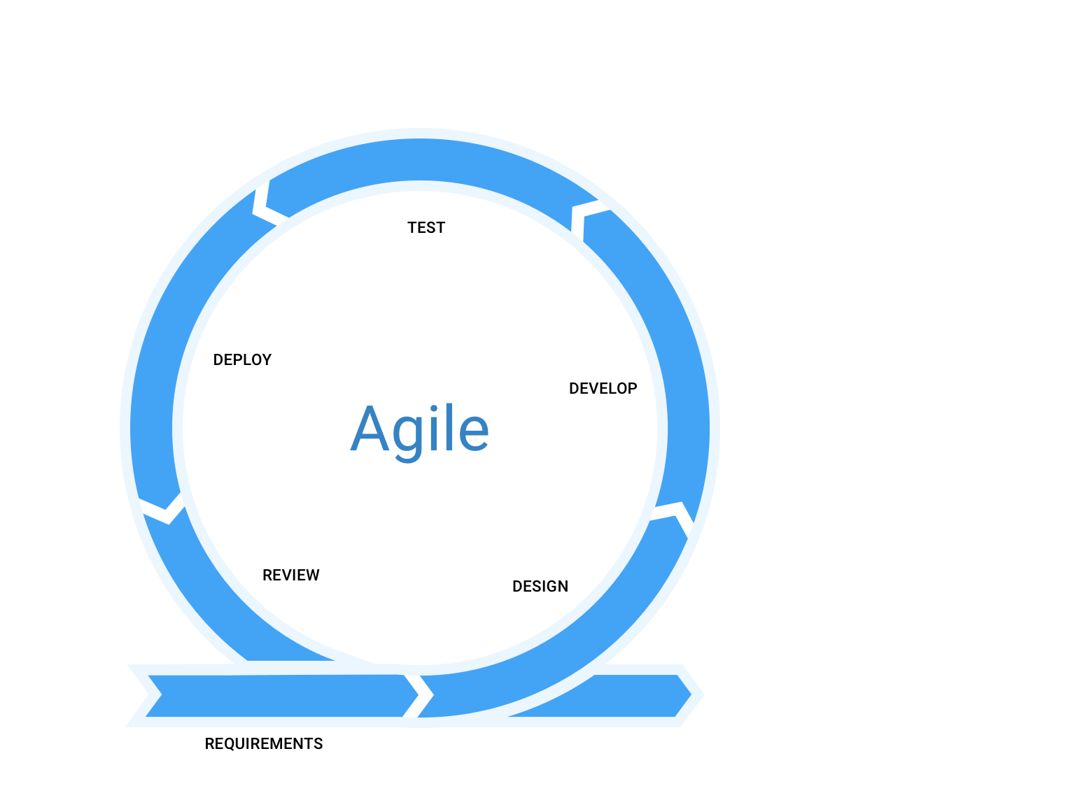



What tools we may need?
Code quality analysis tools
Test automation tools
Performance testing tools
Continuous integration tools
Deployment tools
Code development tools (IDE)
Source code management tools
Build tools
Unit testing tools
Team collaboration and
Communication tools
Requirement management tools

Slide 7
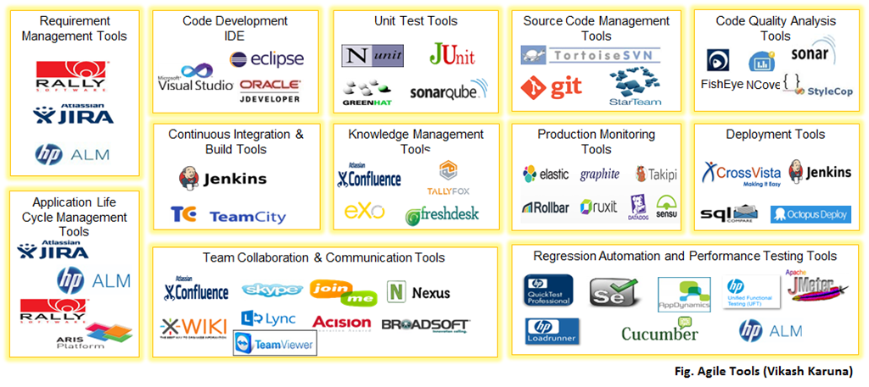
What else we may need?
Knowledge management tools
Production monitoring tools
Application Life cycle management tools
Analytics tools

Slide 8
Requirement management
Requirements management is the process of documenting, analyzing, tracing, prioritizing and agreeing on requirements and then controlling change and communicating to relevant stakeholders. It is a continuous process throughout a project. A requirement is a capability to which a project outcome (product or service) should conform.
In today’s world of development, it becomes utterly necessary to track changes in the requirement at every step, automatically. Audit trail of requirements is done more efficiently with the involvement of tools.

Slide 9

Atlassian Jira
“Jira Software is built for every member of your software team to plan, track, and release great software.”
Plan: Create user stories and issues, plan sprints, and distribute tasks across your software team.
Track: Prioritize and discuss your team’s work in full context with complete visibility.
Release: Ship with confidence and sanity knowing the information you have is always up-to-date.
Report: Improve team performance based on real-time, visual data that your team can put to use.

Slide 10
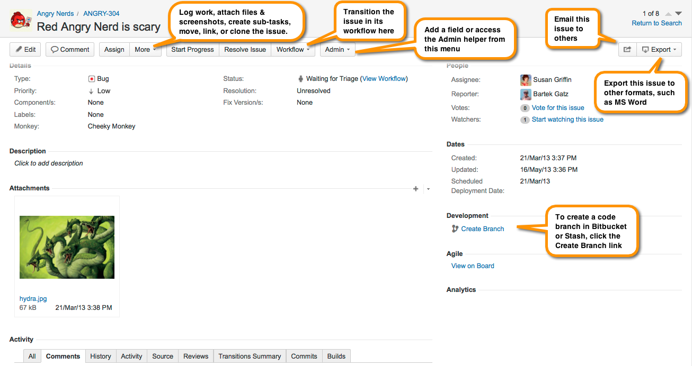
Key terms to know
Issues: A Jira 'issue' refers to a single work item of any type or size that is tracked from creation to completion.
Notes:
Other commonly used terms for issues are 'requests', 'tickets' or 'tasks'.

Slide 11
Statuses
Different statuses are used to indicate the progress of a project like To do, InProgress, Open, Closed, ReOpened, and Resolved.
Likewise, you have resolutions and priorities, in resolution it again tells about the progress of issue like Fixed, Won't fix, Duplicate, Incomplete, Cannot reproduce, Done
You can set also the priorities of the issue whether an issue is critical, major, minor, blocker and Trivial.
Sub-Task
Subtask issues are useful for splitting up a parent issue into a number of smaller tasks that can be assigned and tracked separately. It addresses issues more comprehensively and segregates the task into smaller chunks of task to do.

Slide 12
Projects
A project is, quite simply, a collection of issues that are held in common by purpose or context.
For example, a JIRA project could be:
  a software development project
  a marketing campaign
  a helpdesk system
  a leave request management system
  a website enhancement request system
Every issue belongs to a project. Each project has a name (e.g. Website Issues) and a key (e.g. WEB). The project key becomes the first part of that project's issue keys, e.g. WEB-101, WEB-102
Notes:
. Issues grouped into projects can be configured in a variety of ways, ranging from visibility restrictions to available workflows. Jira Software projects are flexible working spaces that allow you to group like issues by team, business unit, product, or stream of work. Projects don't need to be tied to the same delivery date.

Slide 13
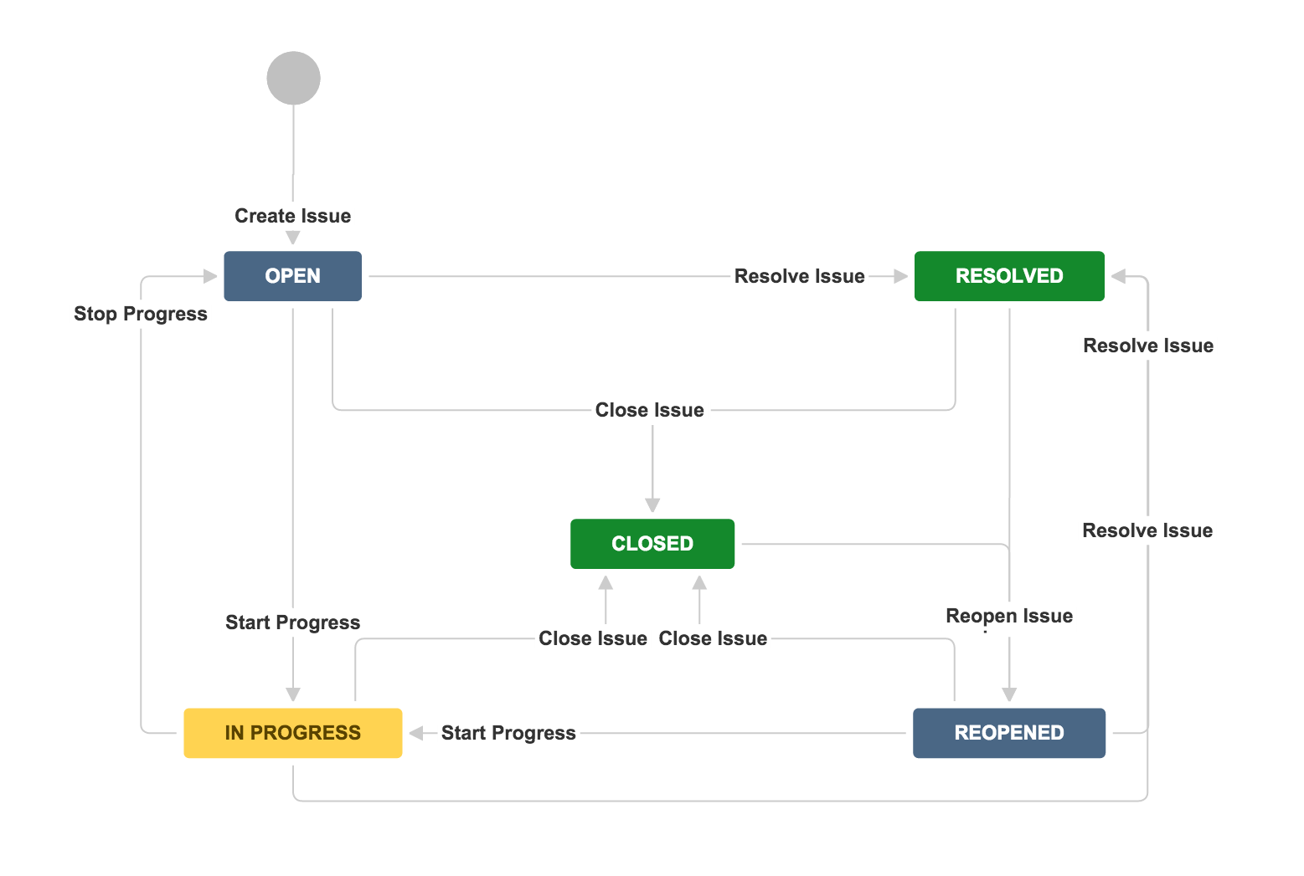
Workflows
Represent the sequential path an issues takes from creation to completion.
A basic workflow might look something like this:

Slide 14
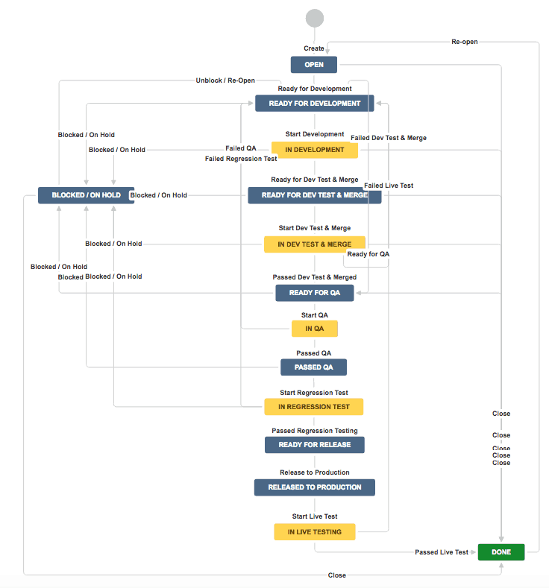
Not so effective workflow

Slide 15
Version: For some types of projects, particularly software development, it is useful to be able to associate an issue with a particular project version (e.g. 1.0 beta, 1.0, 1.2, 2.0).
Issues have two fields that relate to versions:
  Affects Version(s) — this is the version(s) in which the issue is manifesting. For instance, a software bug might affect versions 1.1 and 1.2.
  Fix Version(s) — this is the version(s) in which the issue was (or will be) fixed. For instance, the bug affecting versions 1.1 and 1.2 might be fixed in version 2.0. Note that issues which do not have a Fix Version are classified as Unscheduled.
Versions can be in one of three states:
  Released,
  Unreleased or
  Archived.
Versions can also have a Release Date, and will automatically be highlighted as 'overdue' if the version is Unreleased when this date passes.

Slide 16
Key terms and concepts on scrum board
Sprint: A time-boxed period of time, typically two weeks, during which a "Done," useable, and potentially releasable product increment is created.
Backlog: Owned by the Product Owner, this is a list of features, defects, enhancement, and experiments that need to be done. Each item has a description, rank, size estimate, and value.
User story: Backlog items can be written as stories about a user's experience with a product or feature. A popular format is:
As a <role>, I want to <action> so that <value or justification>

Slide 17
Issue: Also known as the User Story, in a Jira Scrum Board the issue contains all tasks, dependencies, and relevant information related to a single item of work.
Epic: An epic captures a large body of work. It is essentially a large user story that can be broken down into a number of smaller stories. It may take several sprints to complete an epic.
Swimlane: A swimlane is a means of categorizing issues on the Jira Scrum Board so that agile teams can easily see issues grouped by different criteria, say by user.

Slide 18
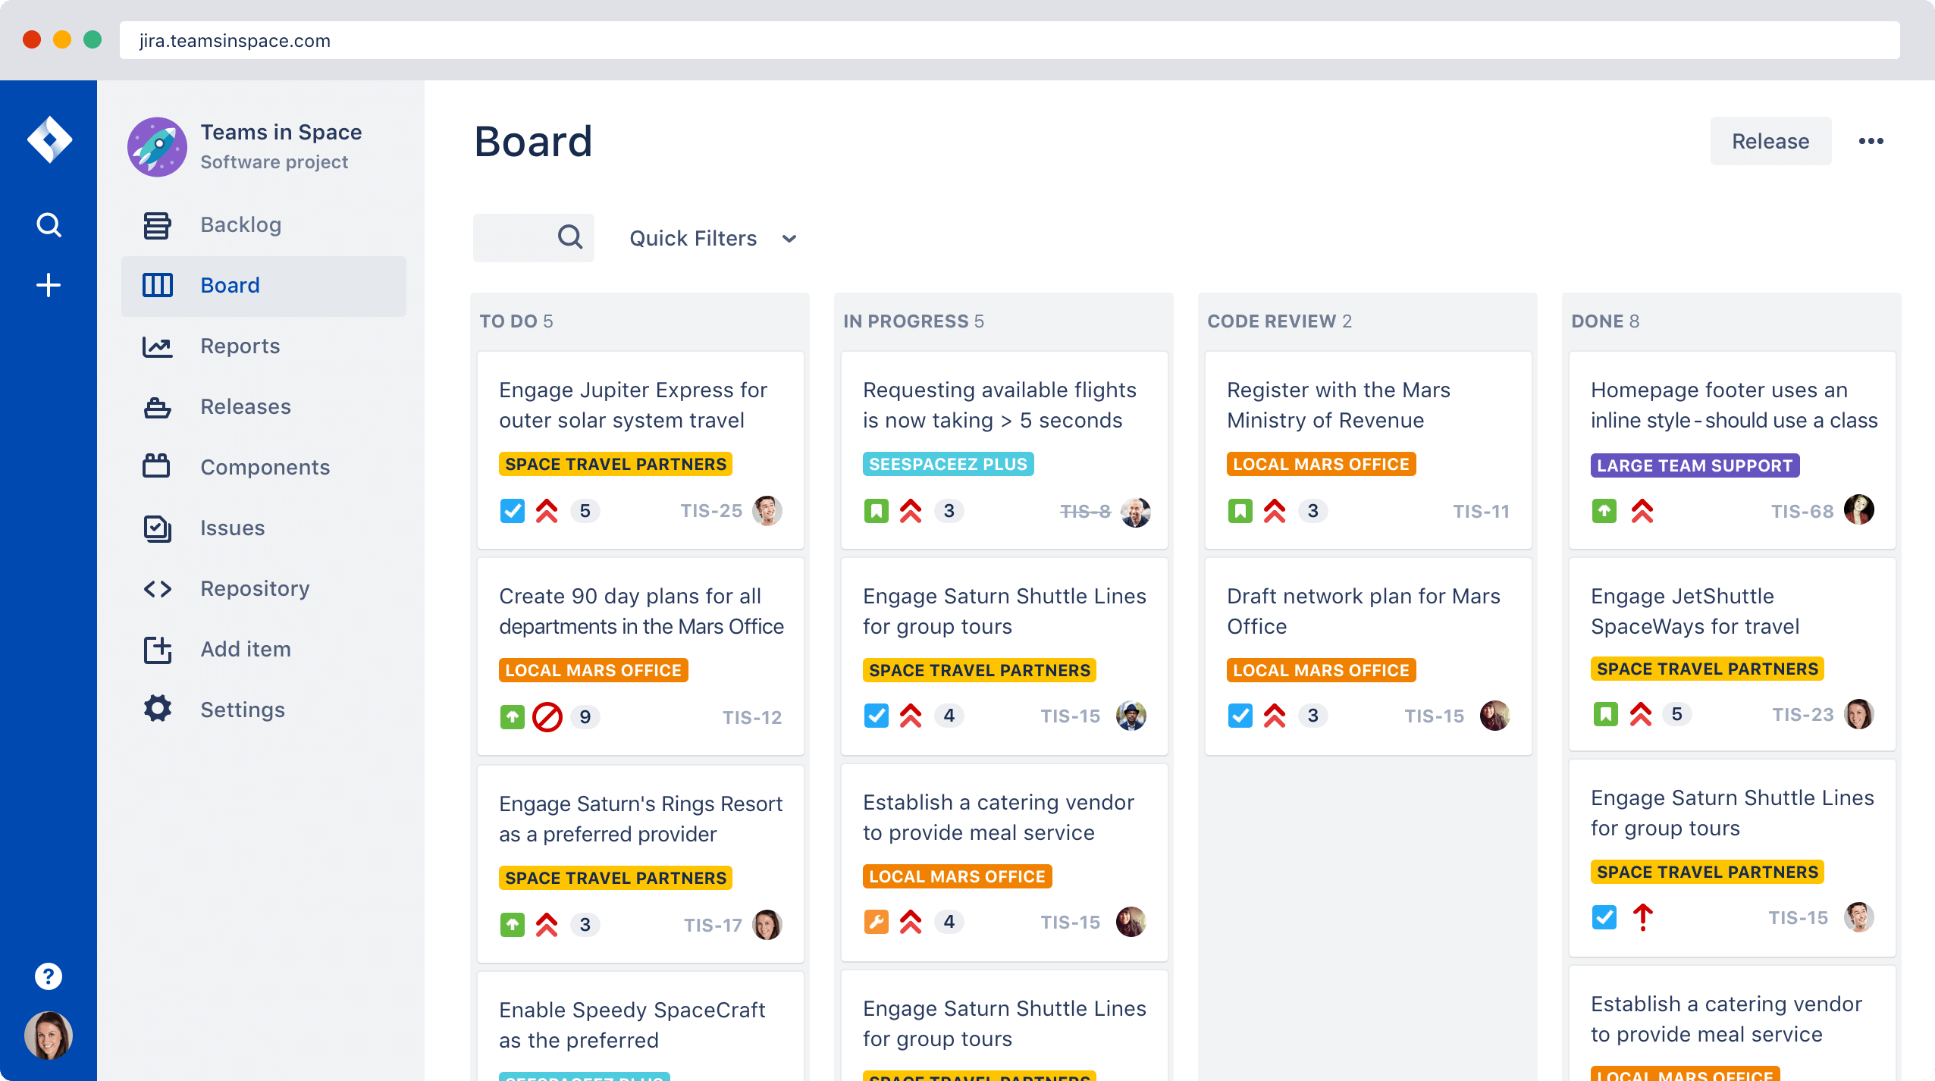

Slide 19
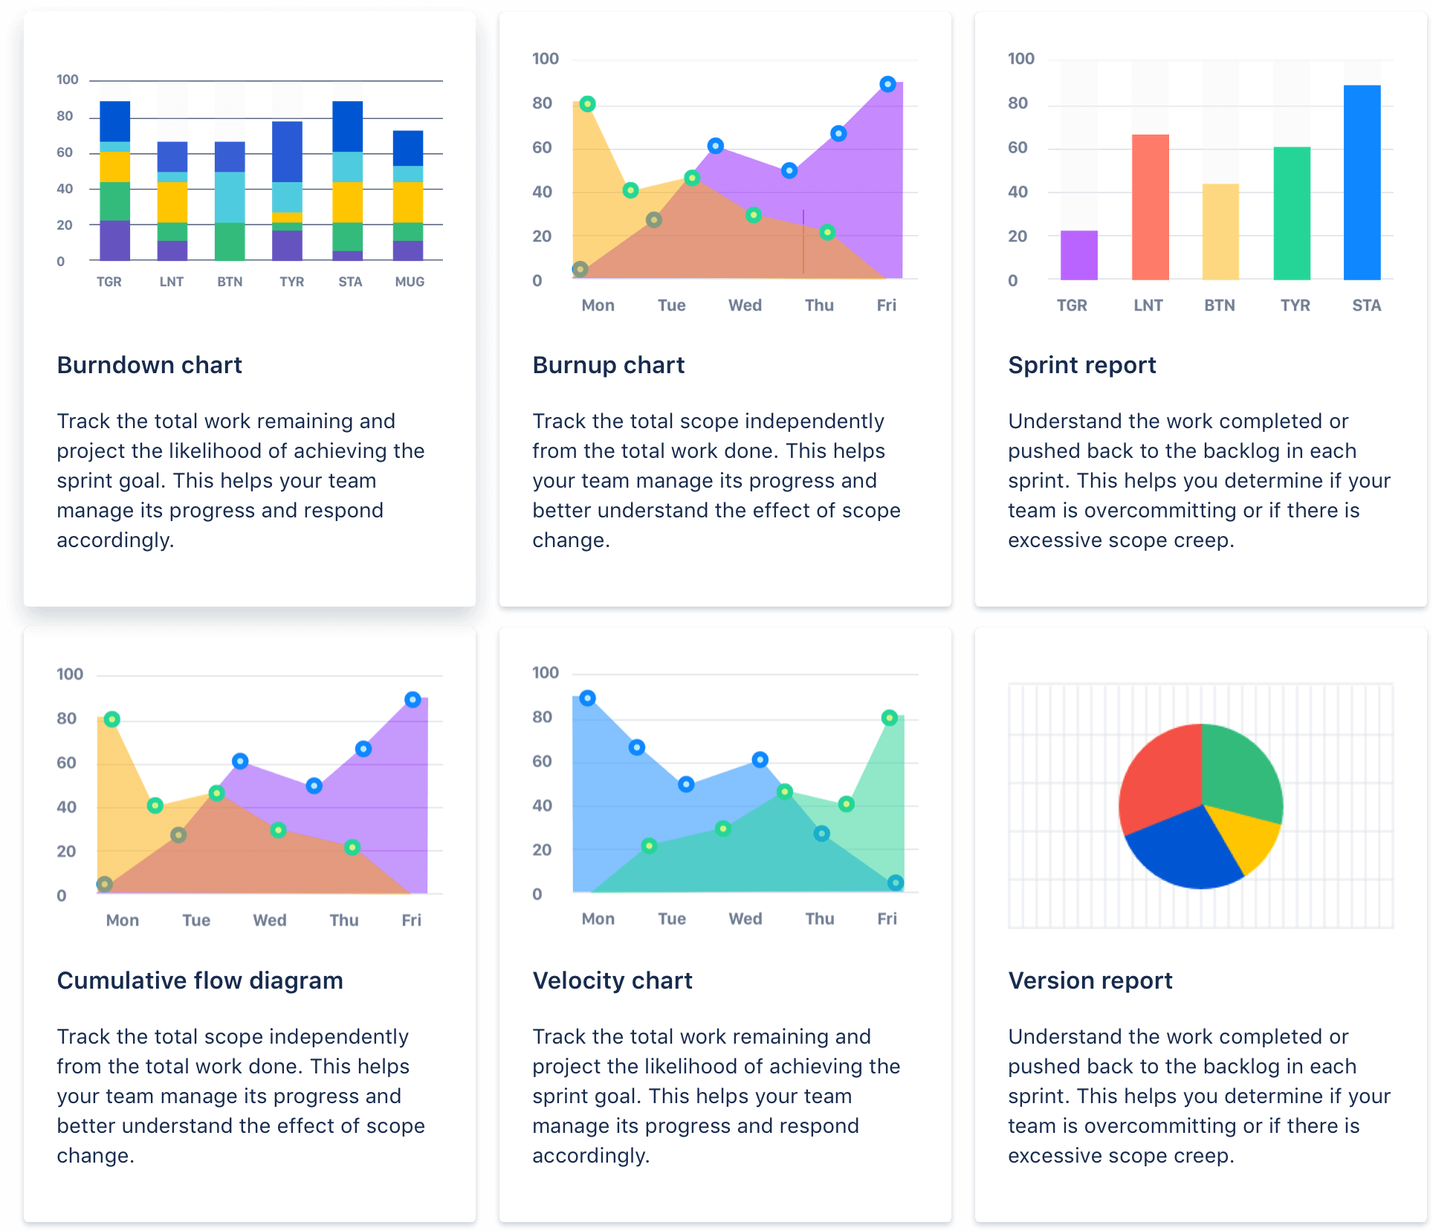
Agile Reporting

Slide 20
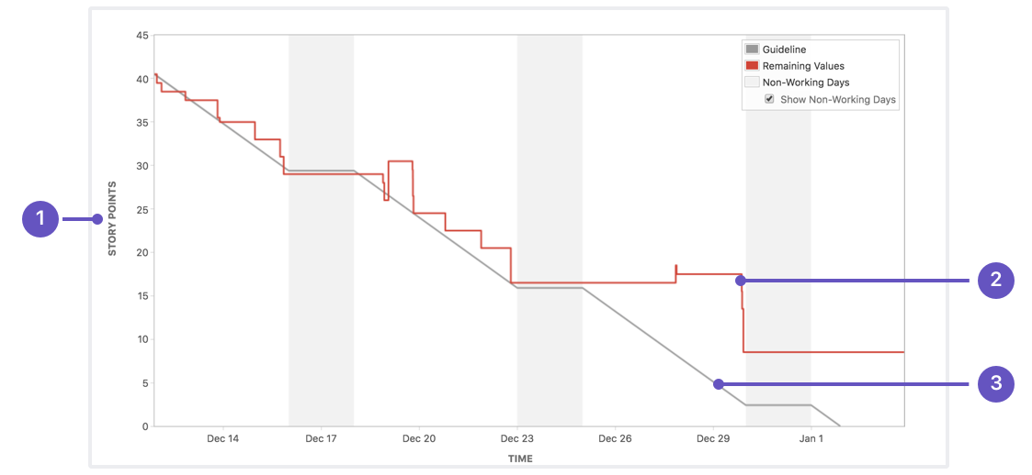
Sprint burndown
Scrum teams organize development into time-boxed sprints. At the outset of the sprint, the team forecasts how much work they can complete during a sprint. A sprint burndown report then tracks the completion of work throughout the sprint.
Notes:
The x-axis represents time, and the y-axis refers to the amount of work left to complete, measured in either story points or hours. The goal is to have all the forecasted work completed by the end of the sprint.
1) Estimation statistic: The vertical axis represents the estimation statistic that you've selected.
2) Remaining values: The red line represents the total amount of work left in the sprint, according to your team's estimates.
3) Guideline: The grey line shows an approximation of where your team should be, assuming linear progress. If the red line is below this line, congratulations - your team's on track to completing all their work by the end of the sprint. This isn't foolproof though; it's just another piece of information to use while monitoring team progress.

Slide 21
Epic and release burndown
Epic and release (or version) burndown charts track the progress of development over a larger body of work than the sprint burndown, and guide development for both scrum and kanban teams.
Since a sprint (for scrum teams) may contain work from several epics and versions, it's important to track both the progress of individual sprints as well as epics and versions.

Slide 22
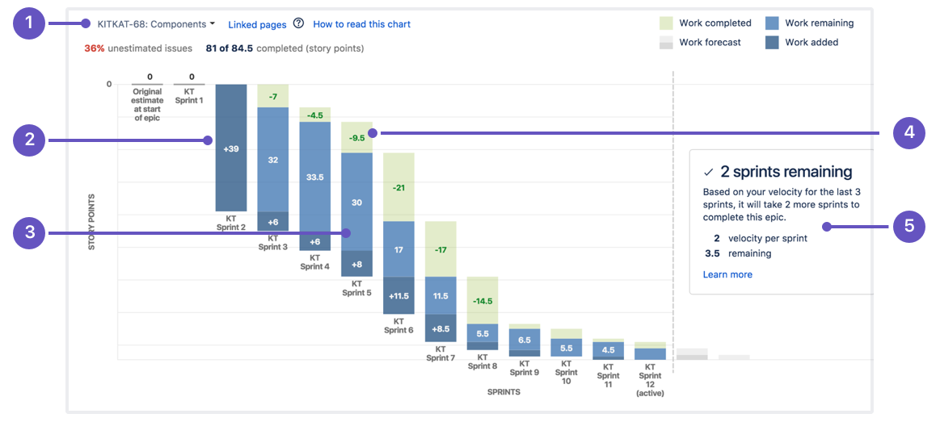
1) Epic menu: Select which epic to view data for.
2) Work added: The dark blue segment shows the amount of work added to the epic in each sprint. In this example, work is measured in story points.
3) Work remaining: The light blue segment shows the amount of work remaining in the epic.
4) Work completed: The green segment represents how much work is completed for the epic in each sprint.
5) Projected completion: The report projects how many sprints it will take to complete the epic, based on the team's velocity.

Slide 23
Velocity
Velocity is the average amount of work a scrum team completes during a sprint, measured in either story points or hours, and is very useful for forecasting.
The product owner can use velocity to predict how quickly a team can work through the backlog, because the report tracks the forecasted and completed work over several iterations–the more iterations, the more accurate the forecast.
It's important to monitor how velocity evolves over time. New teams can expect to see an increase in velocity as the team optimizes relationships and the work process.

Slide 24
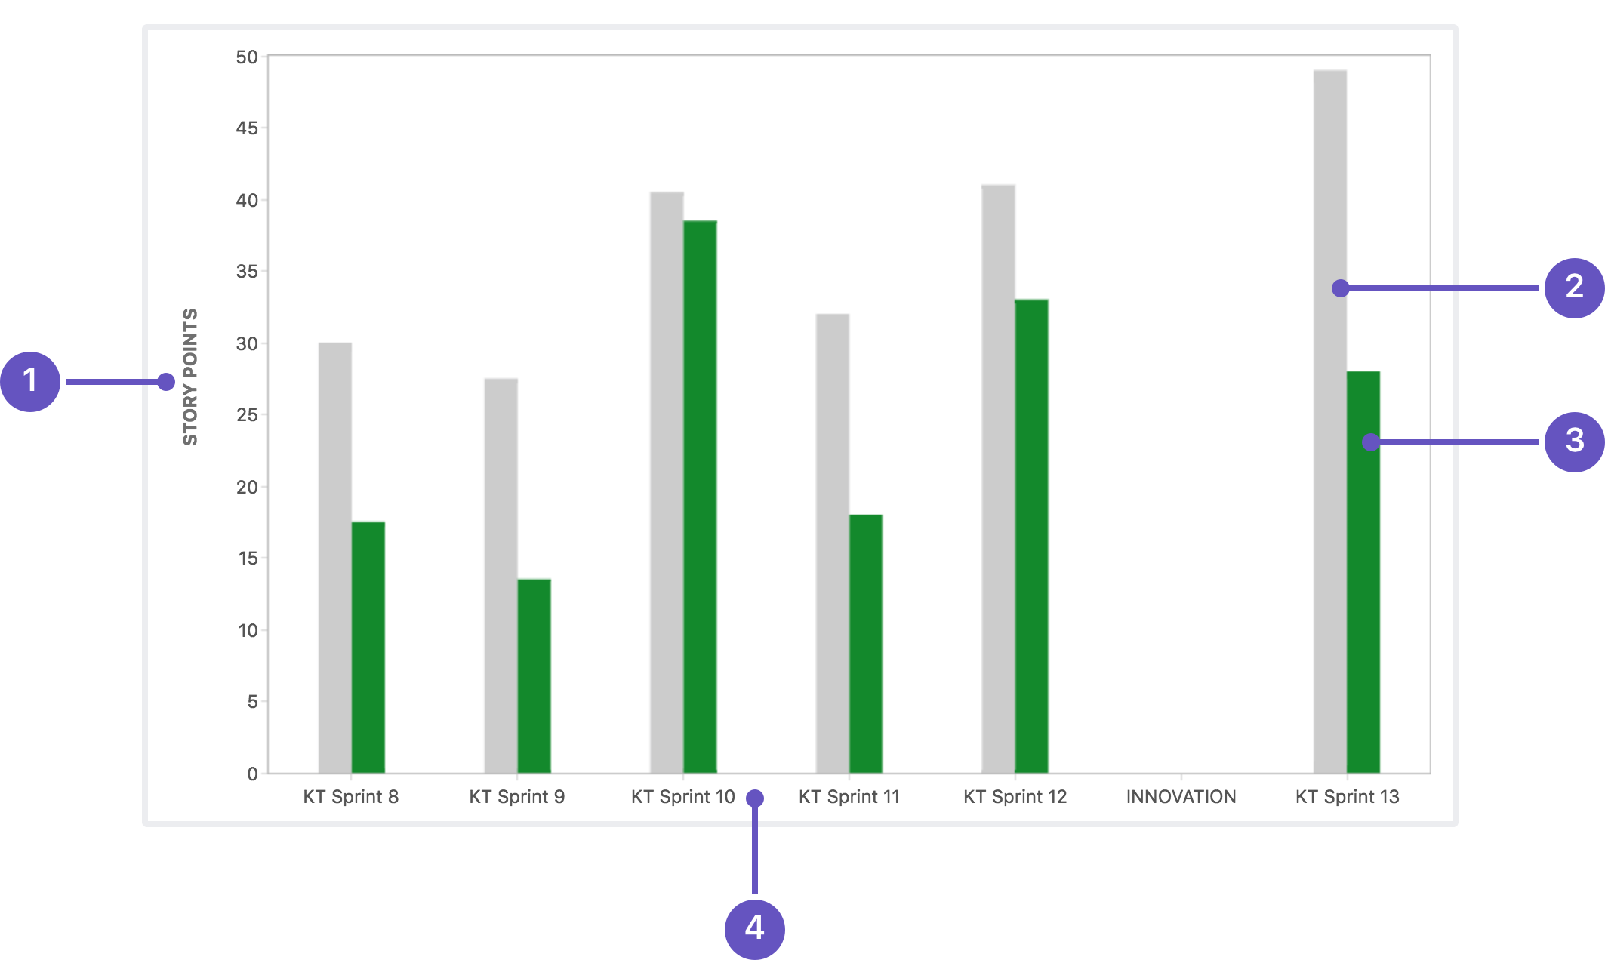
1) Estimation statistic: The y-axis displays the statistic used for estimating stories. In the example above, the team is using story points. Estimates can also be based on business value, hours, issue count, or any numeric field of your choice. See Configuring estimation and tracking for more info.
2) Commitment: The gray bar for each sprint shows the total estimate of all issues in the sprint when it begins. After the sprint has started, any stories added to the sprint, or any changes made to estimates, will not be included in this total.
3) Completed: The green bar in each sprint shows the total completed estimates when the sprint ends. Any scope changes made after the sprint started are included in this total.
4) Sprints: The x-axis displays the last 7 sprints completed by the team. This data is used to calculate velocity.

Slide 25
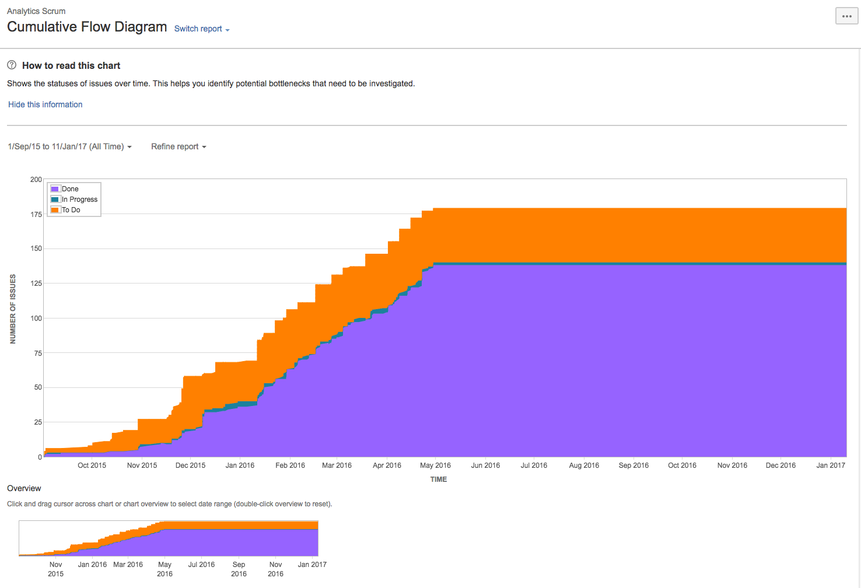
Cumulative flow diagram
The cumulative flow diagram is a key resource for kanban teams, helping them ensure the flow of work across the team is consistent. With number of issues on the Y axis, time on the X axis, and colors to indicate the various workflow states, it visually points out shortages and bottlenecks and works in conjunction with WIP limits.
The cumulative flow diagram should look smooth(ish) from left to right.

Slide 26
Search JIRA like a boss with JQL
There are two types of searches in JIRA: simple and advanced.
Simple search uses a set of forms that a user fills in. The advanced search uses JQL (JQL stands for JIRA Query Language).
It’s the most flexible way to search for issues in JIRA and is for everyone: developers, testers, project managers, and even non-technical business users.
A query has three basic parts: fields, operators, and values.

Slide 27
Field - Fields are different types of information in the system. JIRA fields include priority, fixVersion, issue type, date created, etc.
Value - Values are the actual data in the query: v2.3, Bug, 10/21/2014, etc.
Operator - Operators are the heart of the query. They relate the field to the value. Common operators include equals (=), not equals (!=), less than (<), etc.
Keyword - Keywords are specific words in the language that have special meaning. In this post we will be focused on AND and OR.

Slide 28
Examples
What issues are blocking or critical in Projects A, B, and C?
priority in (Blocker, Critical) AND project in (ProjA, ProjB, ProjC)
What issues are unassigned and have not been updated in the last day?
assignee is EMPTY and updatedDate < -1d
which issues got fixed in the last release.
project = pwc AND status in (resolved, closed) and fixversion = "Sprint A"

Slide 29
Which bugs John Smith resolved in the PWC project?
project = PWC AND status CHANGED FROM "In Progress" TO "Resolved" BY jsmith
Sometimes issues that fail verification or get reopened are of special interest and we want to see why a feature didn't work as intended. To find those bugs it's easy to run this query:
status CHANGED FROM "In Progress" TO "Open"
Similarly, to see what issues were in flight during the current week we can use the following JQL:
status was ("In Progress") DURING (startofweek(), endofweek())
And at the end of the year it can be nice to see how many issues you resolved during the year. All it takes is a little JQL:
resolution changed to "Fixed" by currentUser() during (startOfYear(), endOfYear())

Slide 30
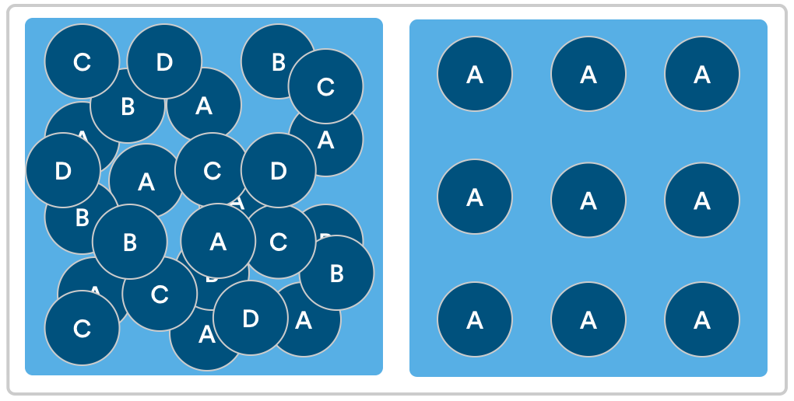
Scoping and sorting
Scoping - Focusing your query so it pulls the right amount of data so the user sees only the information relevant to the current item at hand..

Slide 31
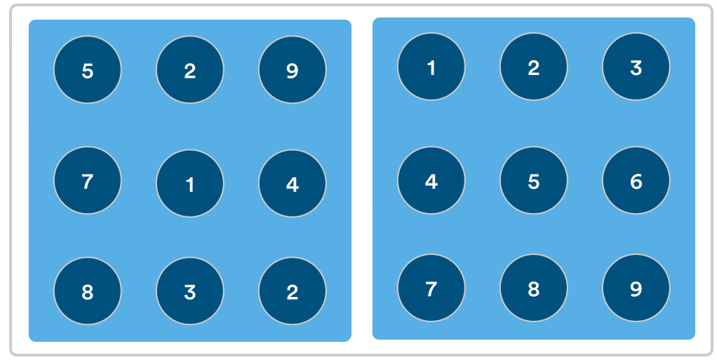
Sorting - Ordering your data such that the most critical set of data is listed first.

Slide 32
Collaboration Tools
A collaboration tool helps people to collaborate.
Collaboration tools can be either of a non-technological nature such as paper, flipcharts, post-it notes or whiteboards.
They can also include software tools and applications such as collaborative software.
What collaboration tools we need?
  Communication: e-mail, VOIP, Video Conferencing tools, etc.
  Documentation: Sharepoint, Confluence, etc.

Slide 33
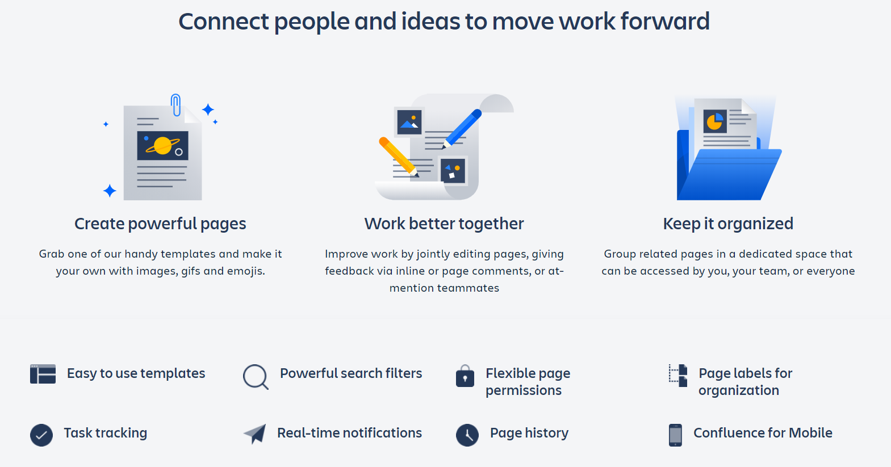
Confluence

Slide 34
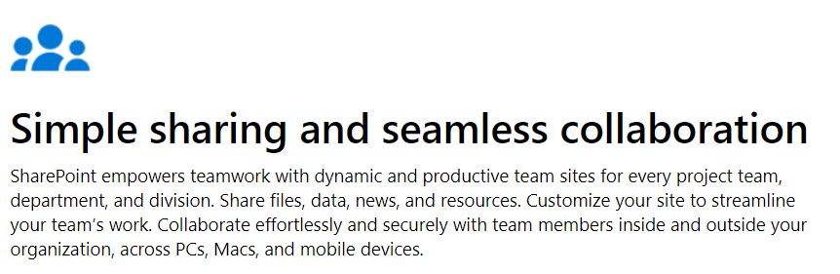

SharePoint
„Share and manage content, knowledge, and applications to empower teamwork, quickly find information, and seamlessly collaborate across the organization.” – Microsoft

Slide 35
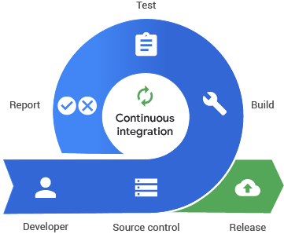
Continuous integration
Continuous integration (CI) is the practice of automating the integration of code changes from multiple contributors into a single software project.
The CI process is comprised of automatic tools that assert the new code’s correctness before integration.
A source code version control system is the crux of the CI process.
The version control system is also supplemented with other checks like automated code quality tests, syntax style review tools, and more.

Slide 36
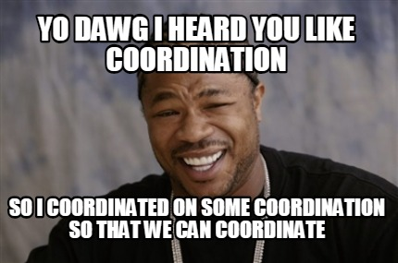
Life without CI
Without CI, developers must manually coordinate and communicate when they are contributing code to the end product. This coordination extends beyond the development teams to the rest of the organization, as well.
Product teams must coordinate when to sequentially launch features and fixes and which team members will be responsible.
This causes slower code releases with higher rates of failure, as it requires developers to be sensitive and thoughtful towards the integrations.

Slide 37


